Slide 1
Agile Principles and Practices
Agile Development Processes
Eric Knauss

Slide 2
Overview
What is Software Engineering?
Repetition: Principles and Practices
XP
Scrum
Kanban (you did watch the video, right?)
(Lean software development)

Slide 3
What is Software Engineering?
Some philosophy

Slide 4
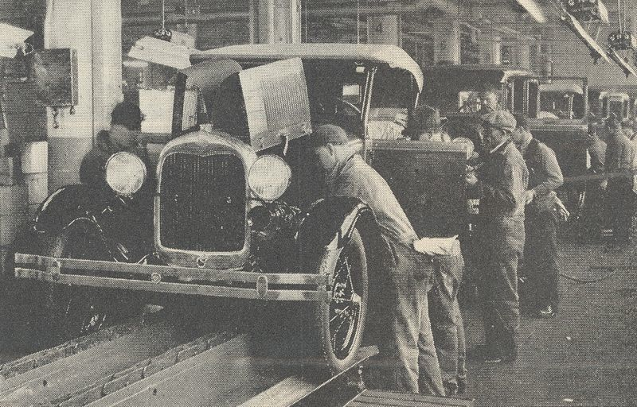

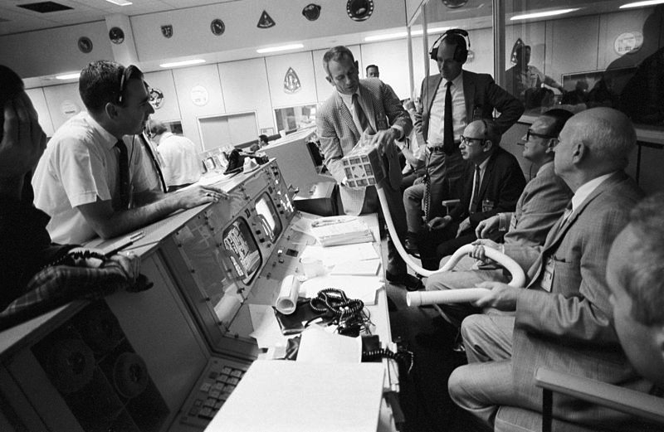
Some comparisons
Production?
Engineering?
Design?
Craft?
Art?
Theory building?
Collaborative game of invention and communication?
Rock-Climbing
Swamp-Game
http://commons.wikimedia.org/wiki/File:Bamun_artisan.jpg
http://en.wikipedia.org/wiki/Fordism
http://en.wikipedia.org/wiki/Aerospace_engineering
Notes:
About the pictures:
Engineering: NASA engineers, seen here in mission control during Apollo 13, worked diligently to protect the lives of the astronauts on the mission.
Production: Ford cars (Model A shown), became a symbol of effective mass production. Efficiency both decreased the price of the cars and allowed Henry Ford to increase the workers' wages. Hence, common workers could buy their own cars. http://en.wikipedia.org/wiki/Fordism

Slide 5
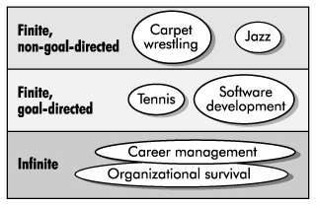
Software Development as a Game
Zero-sum game?
SW-Dev: No, more than one winner
Positional game?
SW-Dev: Some play it like this (comprehensive documentation shows current state of game)
Competitive / Cooperative game?
SW-Dev: Cooperative!!!
Goal directed?
SW-Dev: Definitely
Finite/ infinite?
Cockburn: Agile software development, the cooperative game, 2nd edition

Slide 6

Rock-climbing vs Software Development
Cooperative and goal seeking
Load bearing (limited amount of possible moves)
Team
Individuals with talent (some are simply better)
Skill-sensitive (practice helps to improve)
Training (you need to hone your skllls)
Tools (get more critical the more ambitious the project is)
Resource-limited
Plan
Improvised
Fun
Challenging
Dangerous
http://commons.wikimedia.org/wiki/File:Overhanging_rock_climbing_1.jpg
Cockburn: Agile software development, the cooperative game, 2nd edition

Slide 7
Software Development as Manufacturing
 | Manufacturing Mass Production | Waterfall Model
Hidden Cost | Transportation Managing inventory and storage Capital costs of inventory | Handoffs Lots of open items; can lead to overwhelming the workforce Cost of training people to build software
Risks | Building things you don’t need because production goes on after needs go away Inventory becoming obsolete Huge latency if an error occurs | Building things you don’t need because requirements aren’t clear or customers change their minds Knowledge degrading quickly If a line is discontinued, all WIP wasted Errors in requirements discovered late in the process Errors in completed code discovered late in testing
Lean-Agile Software Development: Achieving Enterprise Agility, by Alan Shalloway, Guy Beaver, and Jim Trott. Chapter 1.

Slide 8
Repetition
Agile Principles and Practices

Slide 9
Agile Principles
Early and continuous delivery of valuable software
Welcome changing requirements, even late
Deliver working software frequently
Business people and developers must work together
Build projects around motivated individuals
Face-to-face communication is most effective and efficient
Working software is the primary measure of progress
Sustainable development
Continuous attention to technical excellence and good design
Simplicity is essential
Self-organizing teams
Regular reflection
Notes:
Take two minutes to discuss with your neighbour: Which are easy, which are hard to follow in your project?

Slide 10
XP Principles
Core
Less central
Rapid feedback
Assume simplicity
Incremental change
Embracing change
Quality work
Teach learning
Small initial investment
Play to win
Concrete requirements
Open, honest communication
Work with people’s instincts, not against them
Accepted responsibility
Local adaptation
Travel light
Hones measurement

Slide 11
XP Practices
Planning game
Small releases
Metaphor
Simple design
Testing
Refactoring
Pair programming
Collective ownership
Continuous integration
40h week
On-site customer
Coding standards

Slide 12
Scrum Principles
Reflection
Stop and review product & process
Self-correction
Based on reflection
Visibility
Everything is visible (=known) for all stakeholders, e.g. plans, schedules, issues, …

Slide 13
Scrum practices
Product backlog vs. Sprint backlog
Sprint planning
Planning poker: estimate cost
ROI (Return on Investment): cost vs. benefit
Retrospective
Fixed sprint length
Burn-down charts
Daily scrum: no longer than 15min

Slide 14
Kanban principles
Start with what you do now
Agree to pursue incremental, evolutionary change
Respect the current process, roles, responsibilities and titles
Leadership at all levels

Slide 15
Kanban core practices
Visualize
Visualization of workflow allows to understand and improve it
Limit Work-in-Progress
Limit the amount of workitems for each step
Introduce a pull-system
Manage flow
Measure how workitems flow through the process and understand, if a change improves the situation
Make policies explicit
Implement feedback loops
Understand (as a team) how good the process is working
Improve collaboratively, evolve experimentally
Whole team needs to share a theory on why (small) change helps

Slide 16
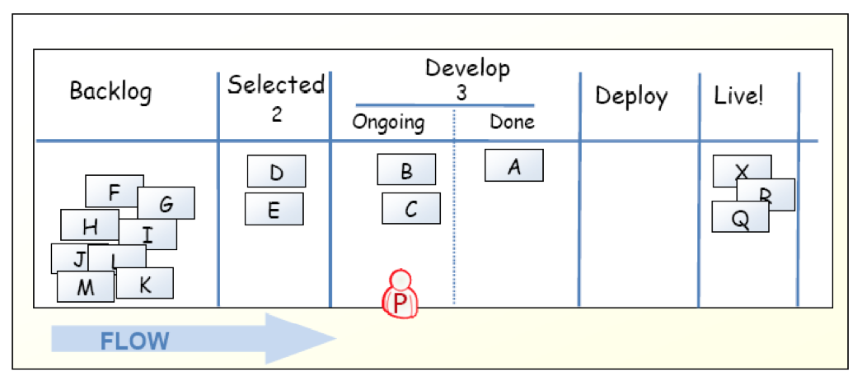
Kanban-Board

Slide 17
Limit work in progress
Prevent context switching
Reduce multi-tasking
performing tasks sequentially yields results sooner
Maximize throughput
Enhance teamwork
working together to make things done
increase cross-functionality

Slide 18
WIP Strategy
Start with some initial value
Small constant (1-3)
number of developers
number of testers
Measure the cycle time
average time of one piece full cycle flow
Change limit to decrease cycle time

Slide 19
Idle Members
Can you help progress an existing kanban? – Work on that.
Don’t have the right skills? – Find the bottleneck and work to release it.
Don’t have the right skills? – Pull in work from the queue.
Can’t start anything in the queue? – Check if there is any lower priority to start investigating.
There is nothing lower priority? – Find other interesting work (refactoring, tool automation, innovation).

Slide 20
Metrics
Stories in progress (SIP)
When story enters stories queue set entry date (ED)
When story enters first process step set start processing date (SPD)
When story is done set finish date (FD)
Cycle time (CT) = FD – SPD
Waiting time (WT) = SPD – ED
Throughput (T) = SIP / CT

Slide 21
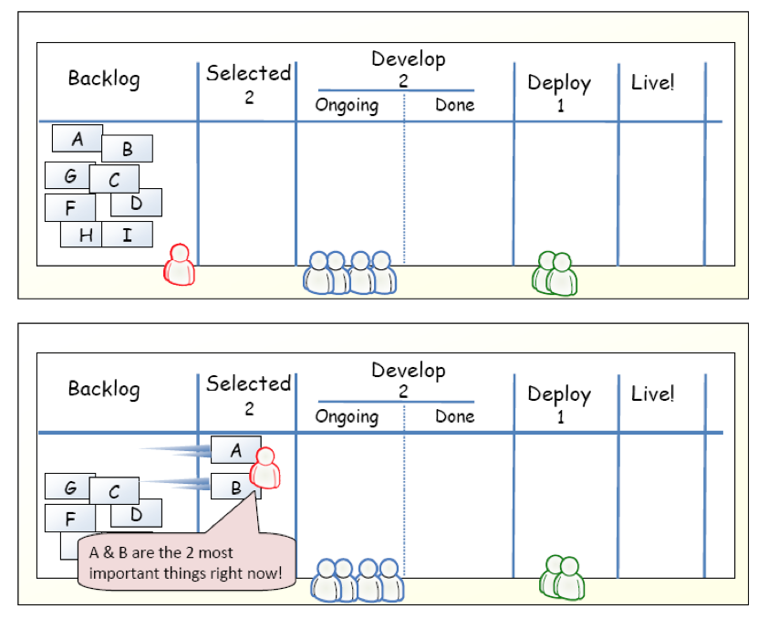
Example

Slide 22
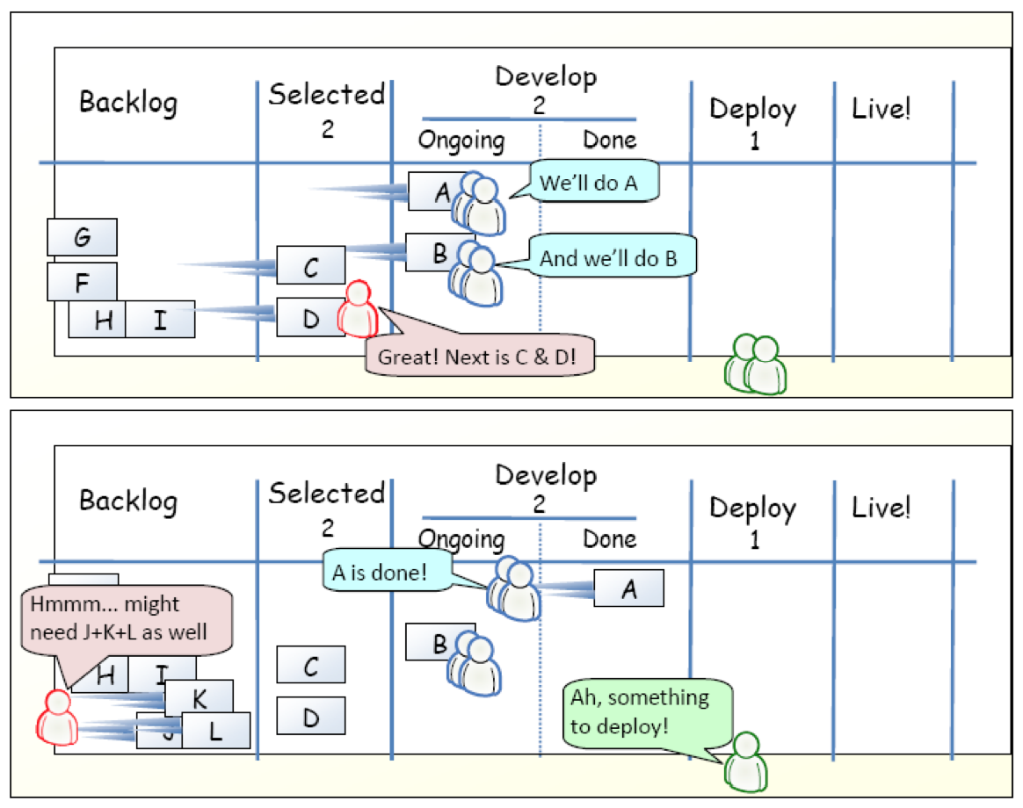
Example

Slide 23
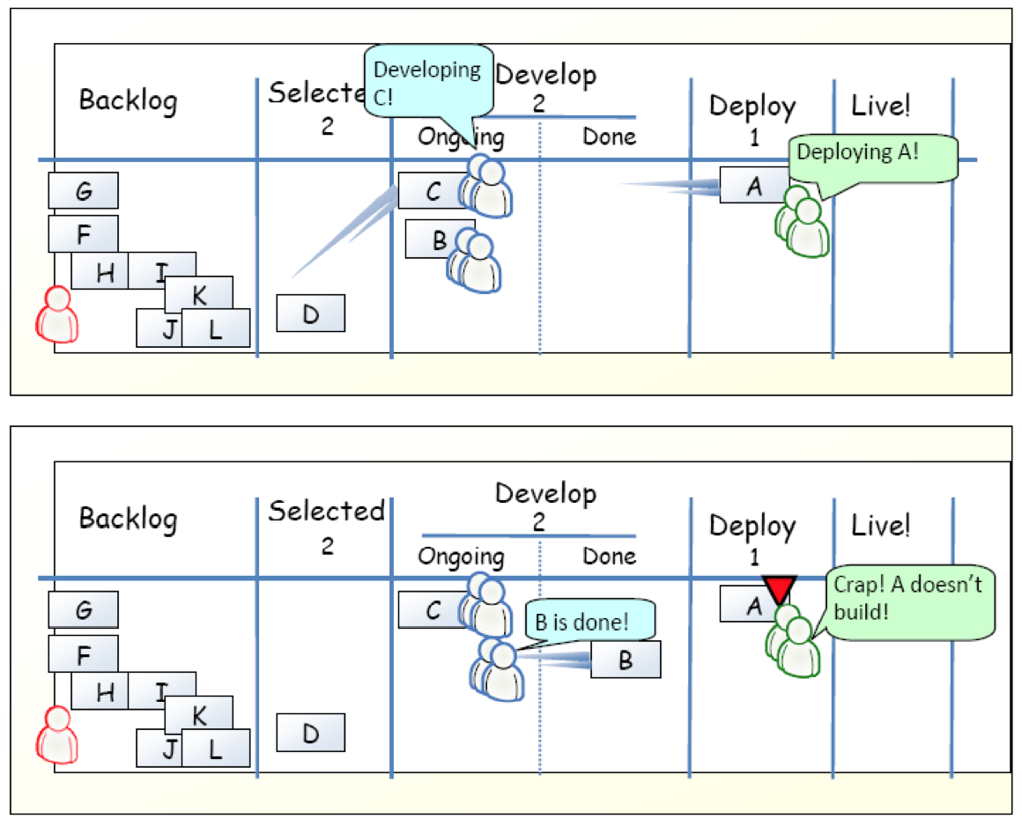
Example

Slide 24
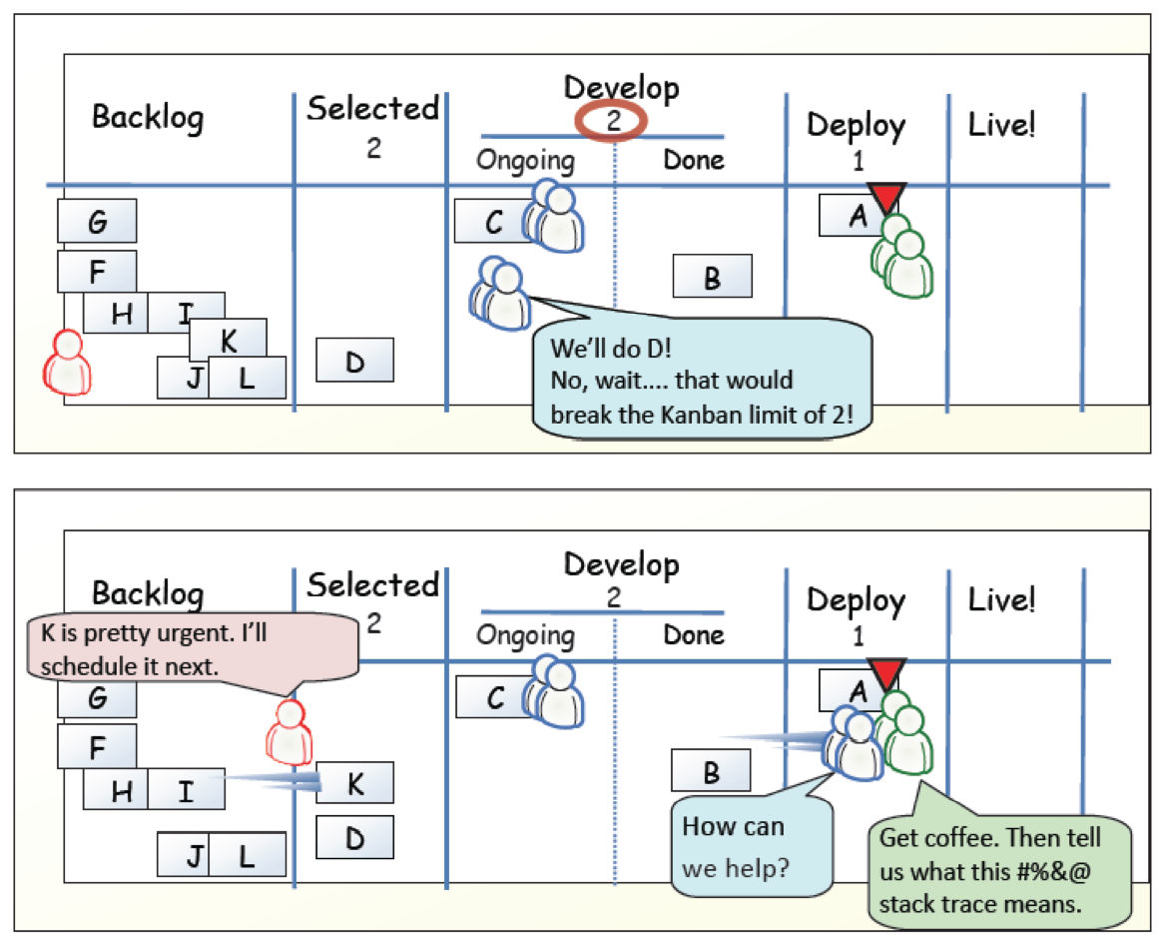
Example

Slide 25
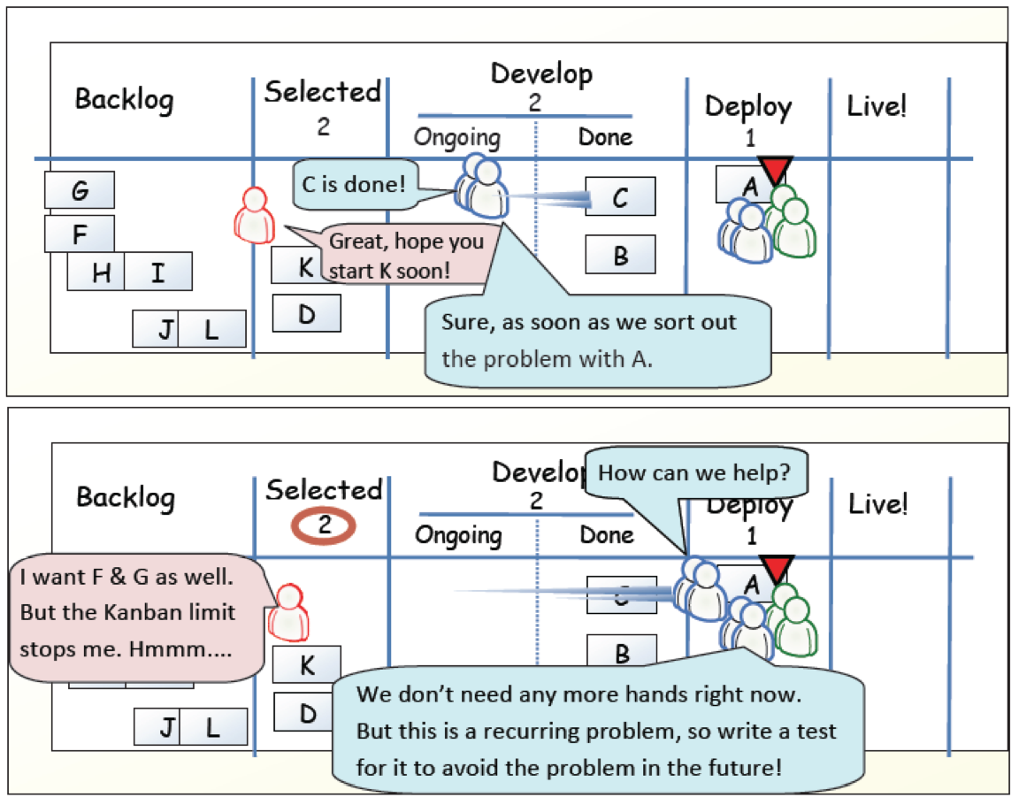
Example

Slide 26
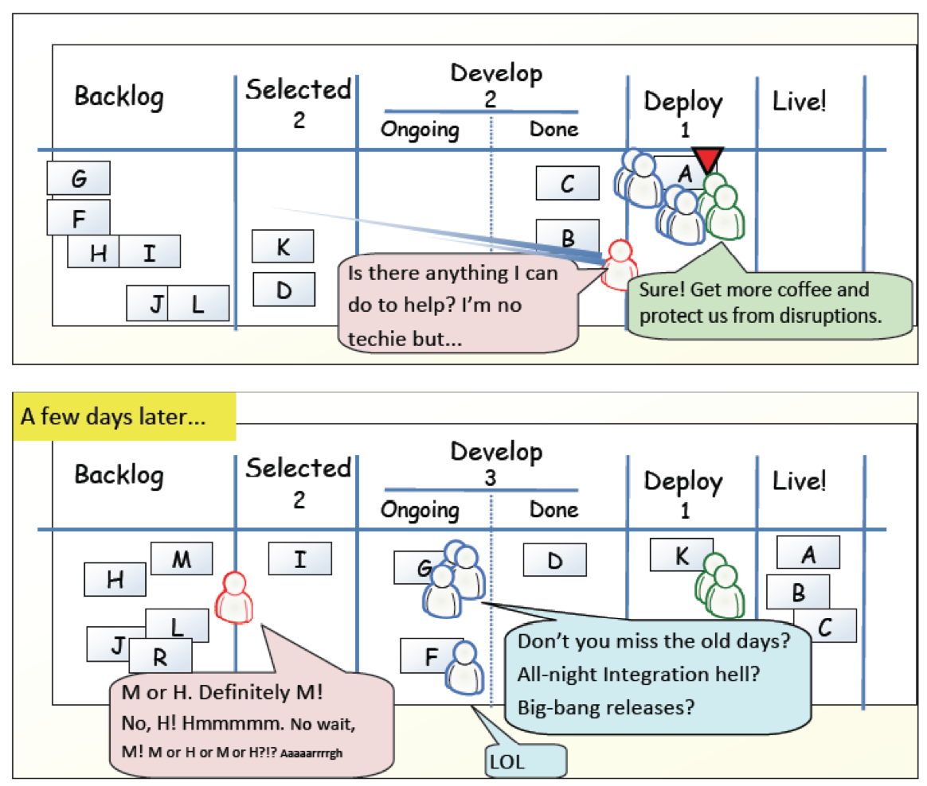
Example

Slide 27
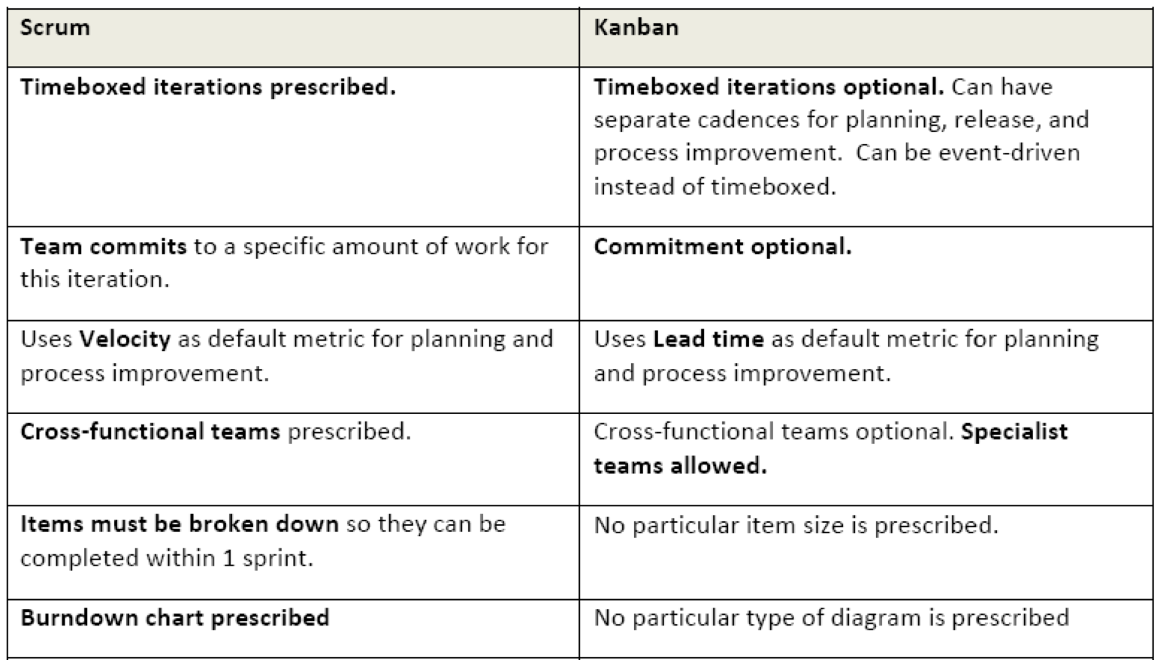
Scrum vs. Kanban

Slide 28
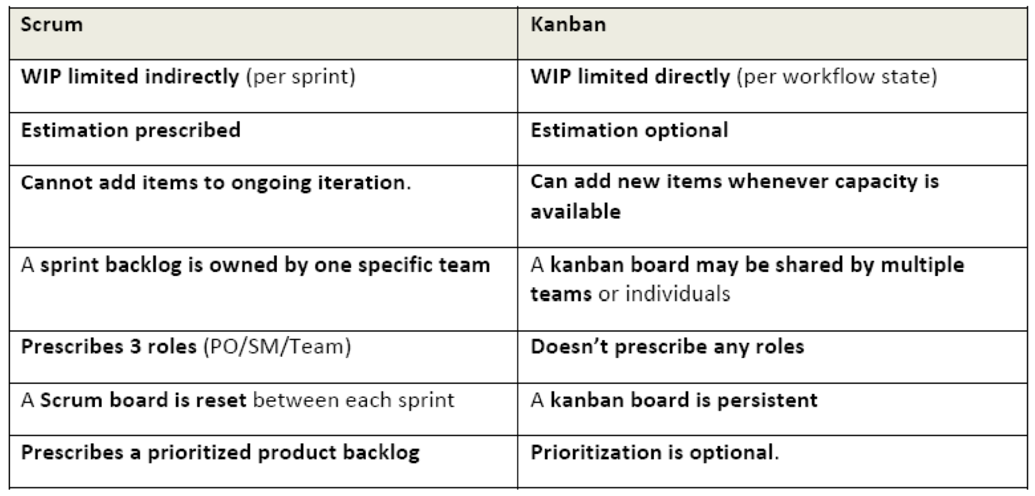
Scrum vs. Kanban

Slide 29
Agile Principles
Early and continuous delivery of valuable software
Welcome changing requirements, even late
Deliver working software frequently
Business people and developers must work together
Build projects around motivated individuals
Face-to-face communication is most effective and efficient
Working software is the primary measure of progress
Sustainable development
Continuous attention to technical excellence and good design
Simplicity is essential
Self-organizing teams
Regular reflection
Notes:
Task: For each of the principles, compare XP, Scrum, and Kanban and discuss differences
NOW: Pick two – the others might be a good exercise for exam and report.

Slide 30
Lean Software Development

Slide 31
Lean History
Toyota (1980s): of "Lean Manufacturing“, revolutionize the automotive industry
eliminate waste
streamline the value chain (even across enterprises)
produce on request (just in time), and
focus on the people who add value.
Mary and Tom Poppendieck: transferred principles and practices from manufacturing to the software development

Slide 32
Lean Mindset
Most errors are of a systemic nature and therefore your development system must be improved.
You must respect your people in order to improve your system.
Doing things too early causes waste.
Do things just before you need to do them
This is called “Just-In-Time,” or JIT.
Focus on shortening time-to-market by removing delays in the development process
using JIT methods to do this is more important than keeping everyone busy.
Lean-Agile Software Development: Achieving Enterprise Agility, by Alan Shalloway, Guy Beaver, and Jim Trott. Chapter 1.

Slide 33
LSD: 7 Principles, 22 Tools
Eliminate Waste – Seeing Waste, Value Stream Mapping
Amplify Learning – Feedback, Iterations, Synchronization, Set-Based Development
Decide as Late as Possible – Options Thinking, The Last Responsible Moment, Making Decisions
Deliver as Fast as Possible – Pull Systems, Queuing Theory, Cost of Delay
Empower the Team – Self-Determination, Motivation, Leadership, Expertise
Build Integrity In – Perceived Integrity, Conceptual Integrity, Refactoring, Testing
See the Whole – Measurements, Contracts
Cristoph Steindl (IBM), Lean Software Development, 2004 (Presentation)

Slide 34
Principle #1: Eliminate Waste
... does not mean to throw away all documentation
spend time only on what adds real customer value.
Eliminating waste is the most fundamental lean principle.
Thus, the first step to implementing lean development is learning to see waste.
The second step is to uncover the biggest sources of waste and eliminate them.
Uncover Waste
Eliminate Waste

Slide 35
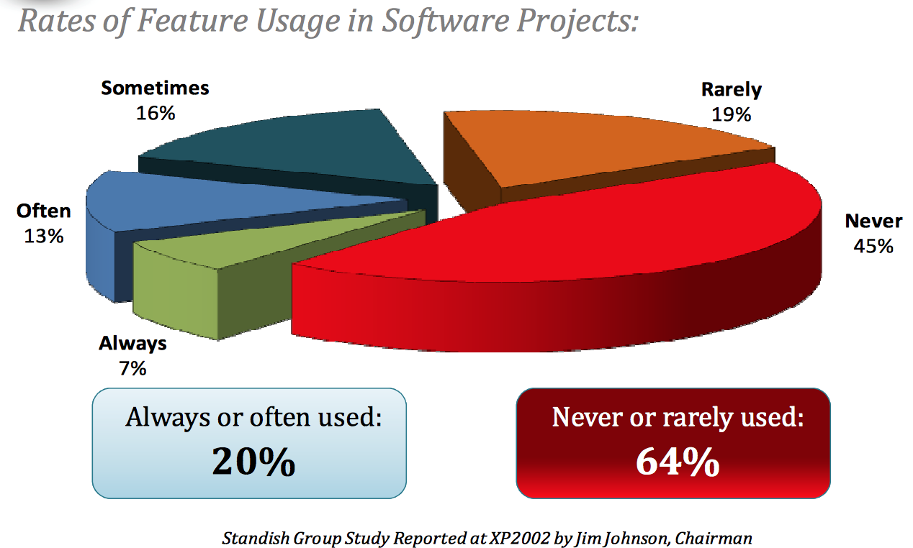
Rates of Feature Usage in Software Projects

Slide 36
#1: Eliminating Waste Tool #1: Seeing Waste
Inventory
Partially done work
Extra processing
Paperwork
Over production
Unused features
Transportation
Task switching
Waiting e.g. for staffing, approval, review, exessive requirements, testing, deployment
Motion
Handovers, finding answers for questions
Defects
Waste produced by defect = impact x time

Slide 37
#1: Eliminating Waste Tool #2: Value Stream Mapping
Pretend you are a customer request
imagine yourself going through each step of your process
Don’t ask people what happens; walk around, look at the data, find out for yourself.
Go to the place where a customer request comes into your organization. Draw a chart of the average customer request, from arrival to completion.
Working with the people involved in each activity, sketch all the process steps necessary to fill the request, as well as the average amount of time that the request spends in each step.
At the bottom of the map, draw a timeline that shows how much time the request spends in value-adding activities and how much time it spends in waiting states and non-value adding activities.

Slide 38
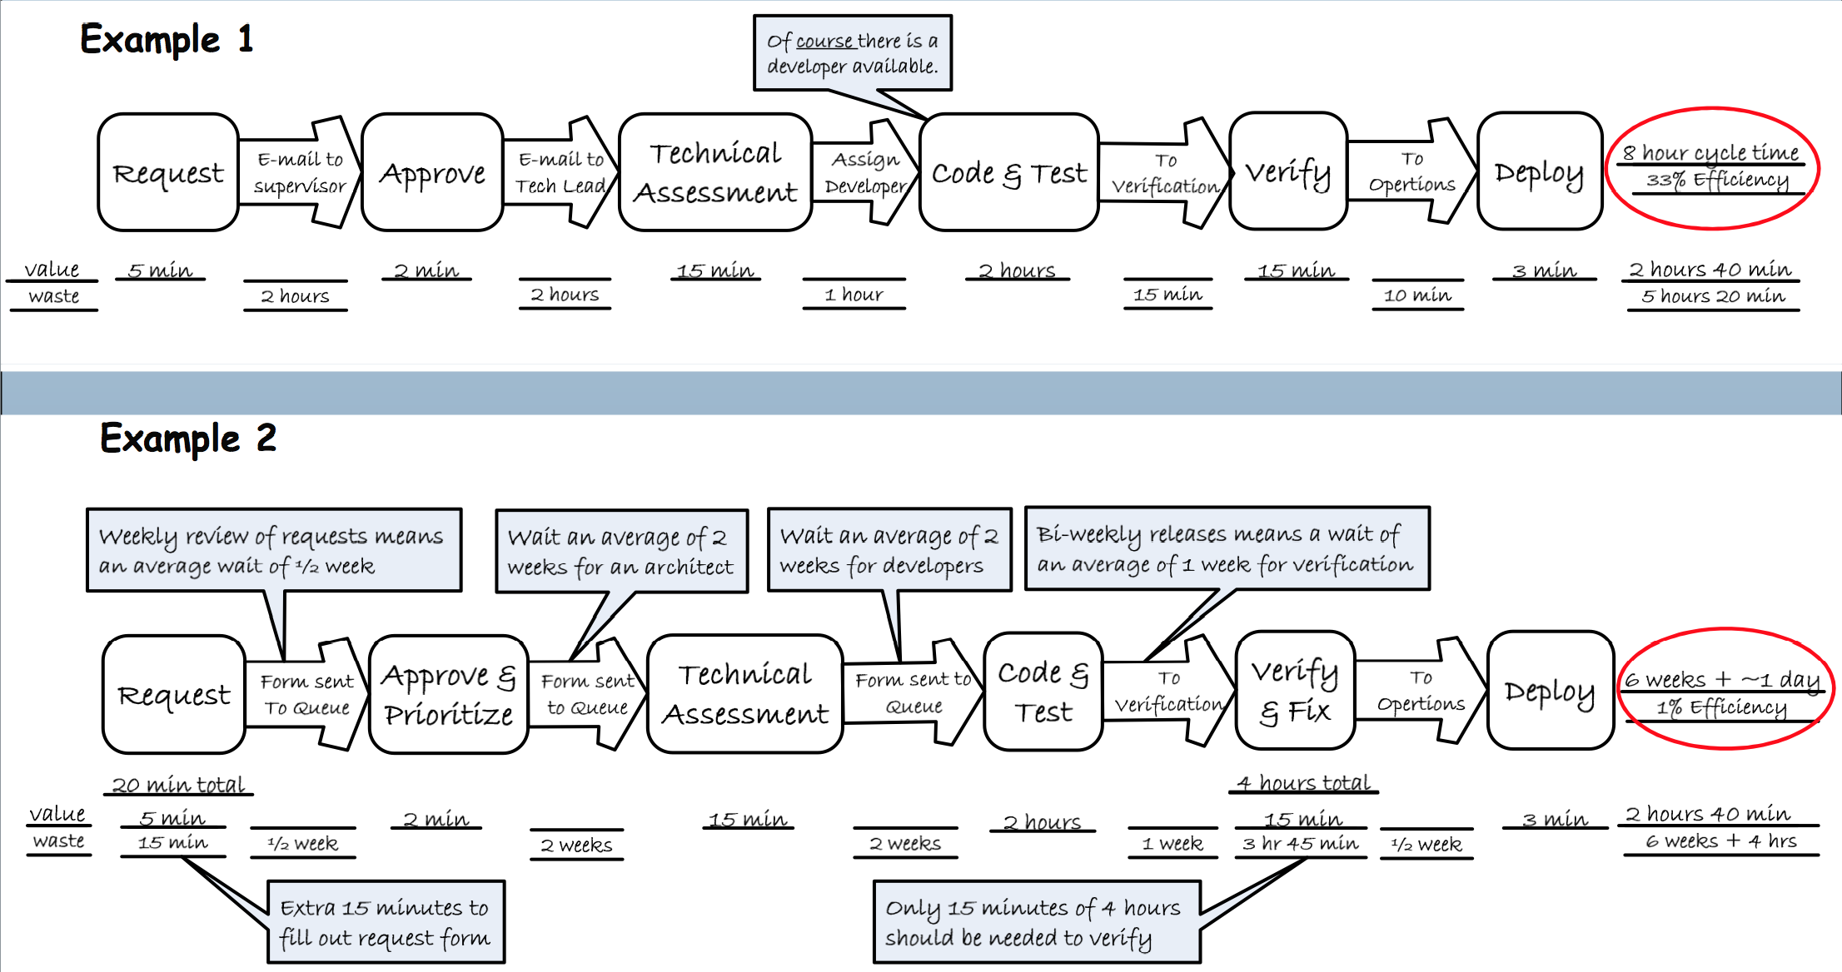
Examples: Value-Stream Mapping
Mary & Tom Poppendieck: Lean Software Development Workshop 2008

Slide 39
#Principle 2: Amplify Learning
Imagine a company with SW development challenges
Usual reaction: Increase discipline / control
Specify requirements more completely
All agreements with customer are written
Changes are controlled more carefully
More tracing
…
As control theory predicts, this generally makes a bad situation worse

Slide 40
#2: Amplify Learning Tool #3: Feedback
If a problem develops
Make sure that all feedback loops are in place
Increase the frequency of feedback loops in problem areas
Instead of… | …focus on
Gather more requirements | Discuss UI prototypes
Accumulate defects | Test as soon as code is written
More documentation and detailed planning | Check out ideas by writing code
Study carefully which tool to use | Bring top 3 candidates in house and test them

Slide 41
#2: Amplify Learning Tool #4: Short iterations
Short iterations
increase control,
help synchronizing developers and customer
Force decisions to be made
------------------------------------------------------------------------
Waterfall Process
X
Increment 1
Increment 2
Increment 3
X

Slide 42
#2: Amplify Learning Tool #5: Synchronisation
Fundamental for every complex development process: Sync individuals that work on the same thing
Daily within the team
Daily Scrum
Daily Build
Daily System Test
Weekly within several teams
Push to master at least weekly
Weekly meetings (e.g. Scrum-of-Scrum)

Slide 43
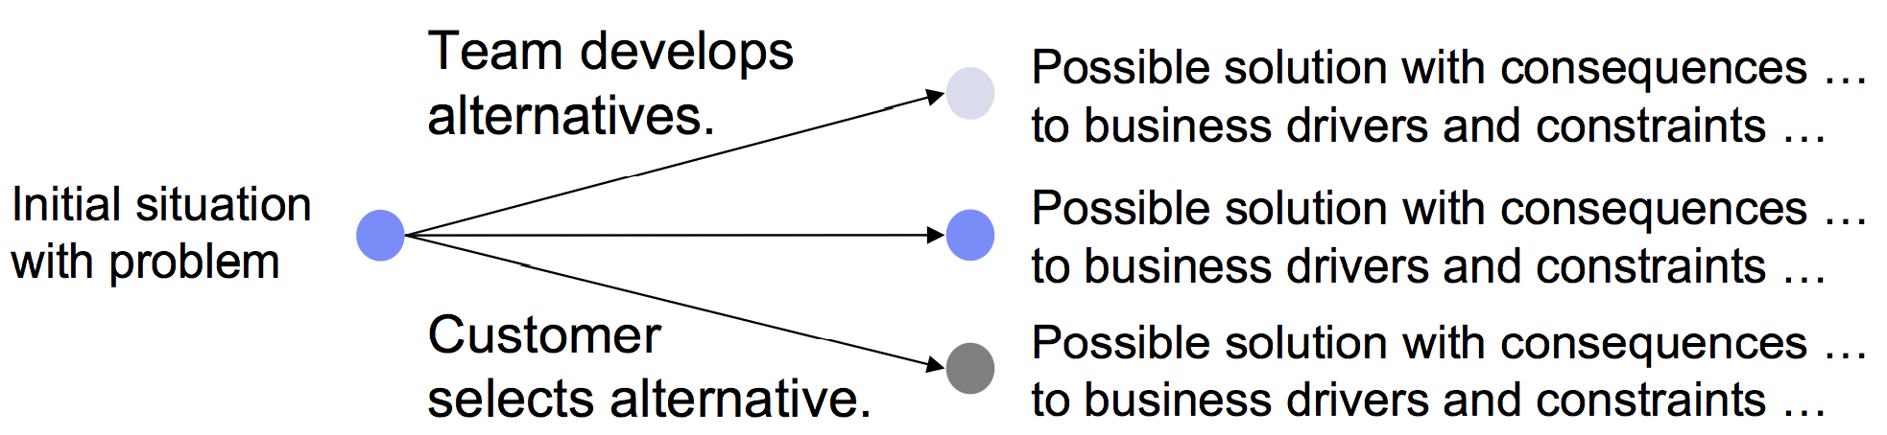
#2: Amplify Learning Tool #5: Set based development
Communicate about constraints, not choices
Use less data to convey more information
Defer making choices until they have to be made

Slide 44
Principle #3: Decide as late as possible
…does not mean to procrastinate,
but to keep your options open as long as practical,
but no longer
Reason
Most common problem: Drill down to details too fast
In the presence of the risk to make big mistakes: survey the landscape and delay detailed decisions
Wait: Is that not equal to sequential development (analyze requirements up-front)?
Sequential development implies depth-first
Breadth-first is far better to manage risk!

Slide 46
Lean principles
Eliminate waste
Unnecessary code, delays, unclear requirements, bureaucracy, …
Amplify learning
Introduce feedback cycles
E.g. iteration retrospective
Meetings of customer representatives and team
Shorter iterations, more reflection
E.g. prototypes for requirements
Decide as late as possible
Reduce waste resulting from wrong decisions
Deliver as fast as possible
Empower the team
Build integrity in
Let customer experience integrity of system – not only quality of the system but also of the way you build it
See the whole
Respect people
Eliminate waste
Defer commitment
Create knowledge
Deliver fast
Build quality in
Optimize the whole
Yasuhiro Monden (1998), Toyota Production System, An Integrated Approach to Just-In-Time, Third edition, Norcross, GA: Engineering & Management Press
Mary Poppendieck, Tom Poppendieck (2003), "Lean Software Development: An Agile Toolkit", Addison-Wesley Professional

Slide 47
See the Whole
This area | Must attend this work
Business | Continuously prioritize and decompose incremental needs across the organization Manage a portfolio of business needs Do release planning
Management | Organize cross-functional teams that can deliver incremental, end- to-end features Manage the value stream Bring visibility to impediments
Delivery team | Work together, every day, and deliver fully tested and integrated code Learn how to deliver business needs incrementally Become proficient at acceptance test-driven development and refactoring
Lean-Agile Software Development: Achieving Enterprise Agility, by Alan Shalloway, Guy Beaver, and Jim Trott. Chapter 1.

Slide 48
Lean practices
Seeing waste
Value stream mapping
Set-based development
Pull systems
Queuing theory
Motivation
Measurements
…

Slide 49
Agile vs. Lean
Agile tends to emphasize communication at the local level
Lean advocates a holistic view of the delivery chain
XP: Decide now, change later
Lean: Defer commitment
Lean-Agile Software Development: Achieving Enterprise Agility, by Alan Shalloway, Guy Beaver, and Jim Trott. Chapter 1.

Slide 51
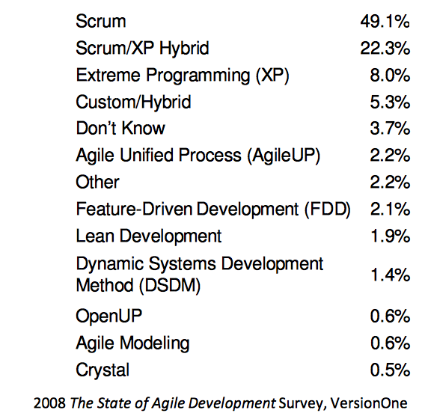
For later use

